Slide 1
Apache Tomcat
Administration

Slide 2
Agenda (1/2)
Apache Tomcat
Web Applications, JSP and Servlets
Tomcat Installation
Tomcat Architecture
Basic Tomcat Configuration
Advanced Tomcat Features
Web Application Configuration
Web Application Administration

Slide 3
Agenda (2/2)
Tomcat and Apache Http Server
JDBC Connectivity
Tomcat Security
Shared Tomcat Hosting
Tomcat Monitoring and Management
Clustering
Logging
Performance tuning

Slide 4
Apache Tomcat

Slide 5
What is Apache Tomcat?
Apache Tomcat is a web Container.
It comes from Apache Software Foundation(ASF).
It is a reference implementation(RI) of Sun’s (Oracle’s) Java EE Web Container.
Created initially by Sun as Java Web Server and later donated the code base to ASF.
Distributed under Apache License.
Supports JSP and Servlets.
Tomcat started as a subproject of the Jakarta project, but now is independent of it.
Tomcat can be freely used in any organization. It can be freely redistributed in any commercial project so long as its license is also included with the redistribution and proper recognition is given.

Slide 6
Tomcat Installation

Slide 7
Session Agenda
Installing the Java Virtual Machine (JVM)
Installing Tomcat on both Windows and Linux
Understanding the Tomcat installation directory structure
Troubleshooting typical problems encountered while installing Tomcat

Slide 8
Installing the Java Virtual Machine (JVM)

Slide 9
Install Java –Hands On
Please follow the given guide to install and configure Java for your OS

Slide 10
Download and Install Tomcat

Slide 11
Hands On Session
Download Tomcat
Install on windows
Install as Windows Service
Install on Linux

Slide 12
Tomcat Architecture

Slide 13
Session Agenda
Tomcat directory structure
Overview of the major Tomcat components
Relationships between the components to make a full-service container

Slide 14
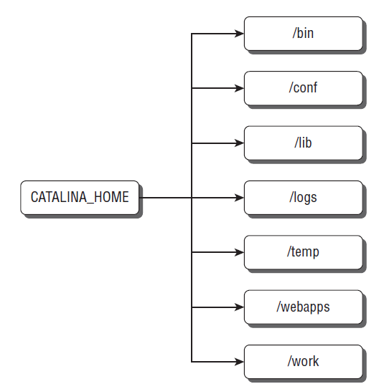
Tomcat Directory Structure
When you download and uncompress the
Tomcat bundle, it places all of its contents in a folder or directory named apache-tomcat-6. X.XX
where X.XX represents the minor version numbers. This installation or top-level directory is what is
known as the CATALINA_HOME

Slide 15
Tomcat Directory Structure
bin Directory
The bin directory contains the scripts and code required to execute the server.
Depending on the version that you download, this directory may contain executable ( .exe ) files for a Windows service installation, or it will just contain the standard Java starting scripts.
Both Unix/Linux shell scripts ( .sh ) and Windows batch ( .bat ) scripts exist here for the standard Tomcat download.
Some JAR files also live in the bin directory, including bootstrap.jar , commons-daemon.jar , and tomcat-juli.jar .

Slide 16
Tomcat Directory Structure
conf Directory
The conf directory contains the files that are necessary to configure and set parameters for Tomcat when it executes.
When Tomcat launches, it investigates the files in this directory and alters/creates the necessary objects and settings to run.
Notes:
The following is a list of the files along with a short description of their use.
❑ catalina.policy : Contains the security policy statements that are implemented by the Java
SecurityManager. It replaces the java.policy file that came with your Java installation. It
is used to prevent rogue code or JSPs from executing damaging code that can affect the
container with calls such as system.exit(0) . It is used only when Tomcat is launched with
the -security command-line parameter.
❑ catalina.properties : Contains lists of Java packages that cannot be overridden by executable
Java code in servlets or JSPs, such as java.* or org.apache.tomcat.* , which could be a
security risk. Also allows the setting to look for common JARs.
context.xml : The common context.xml that is used by all Web applications. By default, this
file is used to set up where to access the web.xml file in Web applications.
❑ logging.properties : The default logging configuration used by the JULI logger. By default, it
uses a ConsoleHandler and FileHandler and sets up the logging level on a per-application or
package basis.
❑ server.xml : The main configuration file for Tomcat. This file is used by the digester to “build”
the container on startup to your specifications. This file follows the Tomcat architecture and will
be discussed in more detail later in this chapter.
❑ tomcat-users.xml : Used for security to access the Tomcat administration applications. It is
used with the default UserDatabase Realm as referenced in server.xml . All credentials are
commented by default and should be changed if uncommented. The Tomcat Administration
application isn’t accessible until entries are uncommented or placed into this file.
❑ web.xml : The default web.xml file that is used by all Web applications. This web.xml sets up
the JSPServlet to allow your applications to handle JSPs and a default servlet to handle static
resources and HTML files. It also sets up the default session timeout and welcome files such as
index.jsp , index.htm , and index.html ; and it sets up default MIME types for the most
common extensions.

Slide 17
Tomcat Directory Structure
lib Directory
The lib directory contains all of the JARs that are used by the container.
This includes the Tomcat JARs and the Servlet and JSP application programming interfaces (APIs).
This is the place where you place JARs that are shared across Web applications or JDBC JARs for connection pools.
Notes:
The following is a list of the files along with a short description of their use.
❑ catalina.policy : Contains the security policy statements that are implemented by the Java
SecurityManager. It replaces the java.policy file that came with your Java installation. It
is used to prevent rogue code or JSPs from executing damaging code that can affect the
container with calls such as system.exit(0) . It is used only when Tomcat is launched with
the -security command-line parameter.
❑ catalina.properties : Contains lists of Java packages that cannot be overridden by executable
Java code in servlets or JSPs, such as java.* or org.apache.tomcat.* , which could be a
security risk. Also allows the setting to look for common JARs.
context.xml : The common context.xml that is used by all Web applications. By default, this
file is used to set up where to access the web.xml file in Web applications.
❑ logging.properties : The default logging configuration used by the JULI logger. By default, it
uses a ConsoleHandler and FileHandler and sets up the logging level on a per-application or
package basis.
❑ server.xml : The main configuration file for Tomcat. This file is used by the digester to “build”
the container on startup to your specifications. This file follows the Tomcat architecture and will
be discussed in more detail later in this chapter.
❑ tomcat-users.xml : Used for security to access the Tomcat administration applications. It is
used with the default UserDatabase Realm as referenced in server.xml . All credentials are
commented by default and should be changed if uncommented. The Tomcat Administration
application isn’t accessible until entries are uncommented or placed into this file.
❑ web.xml : The default web.xml file that is used by all Web applications. This web.xml sets up
the JSPServlet to allow your applications to handle JSPs and a default servlet to handle static
resources and HTML files. It also sets up the default session timeout and welcome files such as
index.jsp , index.htm , and index.html ; and it sets up default MIME types for the most
common extensions.

Slide 18
Tomcat Directory Structure
logs Directory
This directory is used for the logging files that are produced while Tomcat is running.
The JULI logging produces multiple files in this directory, and each log file is created for each day.
temp Directory
This is the temporary directory that Tomcat uses for scratch files and temporary use.
work Directory
Directory for temporary and working files.
This is heavily used during JSP compilation where the JSP is converted to a Java servlet and accessed through this directory.
Notes:
The following is a list of the files along with a short description of their use.
❑ catalina.policy : Contains the security policy statements that are implemented by the Java
SecurityManager. It replaces the java.policy file that came with your Java installation. It
is used to prevent rogue code or JSPs from executing damaging code that can affect the
container with calls such as system.exit(0) . It is used only when Tomcat is launched with
the -security command-line parameter.
❑ catalina.properties : Contains lists of Java packages that cannot be overridden by executable
Java code in servlets or JSPs, such as java.* or org.apache.tomcat.* , which could be a
security risk. Also allows the setting to look for common JARs.
context.xml : The common context.xml that is used by all Web applications. By default, this
file is used to set up where to access the web.xml file in Web applications.
❑ logging.properties : The default logging configuration used by the JULI logger. By default, it
uses a ConsoleHandler and FileHandler and sets up the logging level on a per-application or
package basis.
❑ server.xml : The main configuration file for Tomcat. This file is used by the digester to “build”
the container on startup to your specifications. This file follows the Tomcat architecture and will
be discussed in more detail later in this chapter.
❑ tomcat-users.xml : Used for security to access the Tomcat administration applications. It is
used with the default UserDatabase Realm as referenced in server.xml . All credentials are
commented by default and should be changed if uncommented. The Tomcat Administration
application isn’t accessible until entries are uncommented or placed into this file.
❑ web.xml : The default web.xml file that is used by all Web applications. This web.xml sets up
the JSPServlet to allow your applications to handle JSPs and a default servlet to handle static
resources and HTML files. It also sets up the default session timeout and welcome files such as
index.jsp , index.htm , and index.html ; and it sets up default MIME types for the most
common extensions.

Slide 19
Tomcat Directory Structure
webapps Directory
The webapps directory is where your Web applications ultimately will live.
If you are using an exploded WAR (a WAR file that is decompressed), it needs to be placed in this directory.
Placing a WAR file in this directory also causes Tomcat to deploy the file.
When you deploy a full WAR through the Manager console application or the Tomcat Client Deployer, your WAR file is also placed into this directory.
Notes:
Tomcat comes standard with several applications that reside in this directory:
❑ ROOT : The welcome screen application. This is a special directory that designates the “ / ” root of
your Web container. When you move Tomcat to a production environment you would likely
remove this directory if your application reuses the “ / ” root context.
❑ docs : Contains the Tomcat documentation. It is the same documentation you would find on the
http://tomcat.apache.org/tomcat-6.0-doc Web site.
❑ examples : Contains the JSP and servlet examples.
❑ host-manager : An application that allows you to manage the hosts that run in your application.
Accessible from the /host-manager/html URL. It requires that you have set up proper
credentials in the conf/tomcat-users.xml file to access this application.
❑ manager : An application that allows you to manage your applications in Tomcat. From this
application you can start, stop, reload, deploy, and undeploy your applications. It is accessible
from the /manager/html URL. It requires that you have set up proper credentials in the
conf/tomcat-users.xml file to access this application.

Slide 20
An Overview of Tomcat Architecture

Slide 21
Tomcat Architecture
Tomcat consists of a nested hierarchy of components.
Some of these components are called top-level components because they exist at the top of the component hierarchy in a rigid relationship with one another.
Containers are components that can contain a collection of other components.
Components that can reside in containers, but cannot themselves contain other components, are called nested components .

Slide 22
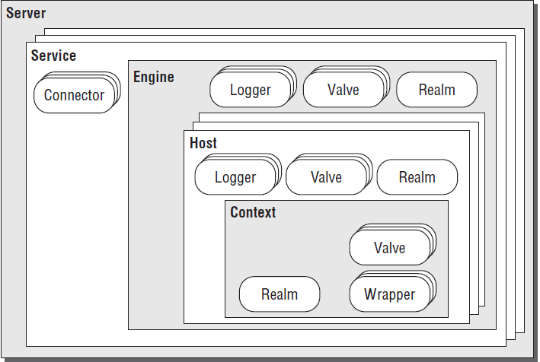

Slide 23
The Server
The Server is Tomcat itself — an instance of the Web application server — and is a top-level component.
It owns a port that is used to shut down the server.
Only one instance of the Server can be created inside a given Java Virtual Machine (JVM).

Slide 24
The Service
A Service groups a container (usually of type Engine) with a set of Connectors and is a top-level component.
An Engine is a request-processing component that represents the Catalina Servlet engine.
It examines the HTTP headers to determine the virtual host or context to which requests should be passed.
Each Service represents a grouping of Connectors (components that manage the connection between the client and server) and a single container, which accepts requests from the Connectors and processes the requests to present them to the appropriate Host.
Each Service is named so that administrators can easily identify log messages sent from each Service.

Slide 25
The Connectors (1/2)
Connectors connect the applications to clients.
They represent the point at which requests are received from clients and are assigned a port on the server.
The default port for non-secure HTTP applications is kept as 8080 to avoid interference with any Web server running on the standard HTTP port, but there is no reason why this cannot be changed as long as the port is free.
Multiple Connectors may be set up for a single Engine or Engine-level component, but they must have unique port numbers.

Slide 26
The Connectors (2/2)
The default Connector is Coyote, which implements HTTP 1.1; Tomcat also comes with an AJP connector.
In addition, the HTTP connector can be used with SSL as well.
Both the HTTP and AJP connectors are fully supported by Tomcat.
However, there are alternative Connectors, such as the old JServ and JK2, which work, but are no longer supported.

Slide 27
The Engine
An Engine is a request-processing component that represents the Catalina Servlet engine.
It examines the HTTP headers to determine the virtual host or context to which requests should be passed.
An Engine may contain Hosts representing a group of Web applications and Contexts representing a single Web application.

Slide 28
The Realm (Under Engine)
The Realm for an Engine manages user authentication and authorization.
During the configuration of an application, the administrator sets the roles that are allowed for each resource or group of resources, and the Realm is used to enforce this policy.
Realms can authenticate against text files, database tables, LDAP servers, and the Windows network identity of the user.

Slide 29
The Valves
Valves are components that enable Tomcat to intercept a request and preprocess it.
They are similar to the filter mechanism of the Servlet specifications, but are specific to Tomcat.
Hosts, Contexts, and Engines may contain Valves. A Valve is essentially a super-filter, very similar to a servlet filter, but it intercepts and invokes at a much higher level.

Slide 30
The Loggers

Slide 31
The Host

Slide 32
The Context

Slide 33
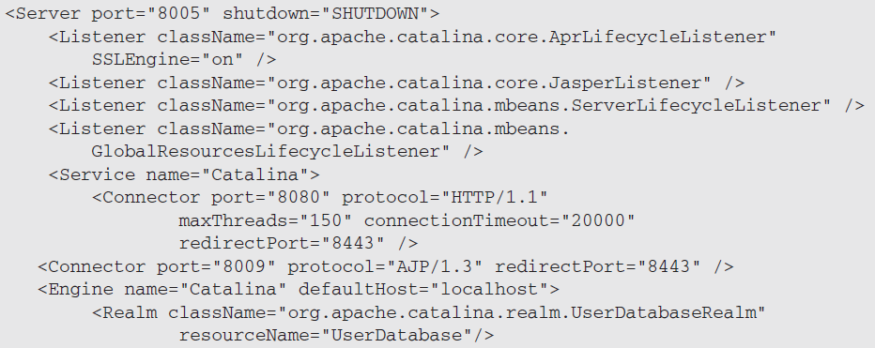
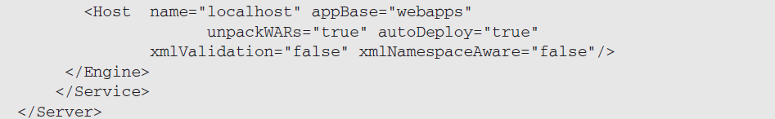
Configuration By Architecture

Slide 34
Basic Tomcat Configuration

Slide 35
Tomcat Configuration files
A Tomcat server instance reads a set of configuration XML files upon startup.
To configure a Tomcat server instance, it is necessary to modify these XML files.
Files are:
server.xml
context.xml
web.xml
Tomcat looks for these configuration files in a specified configuration directory.
This configuration directory is specified via an environment variable.
Tomcat first checks the $CATALINA_BASE ( %CATALINA_BASE% on Windows) environment variable.

Slide 36
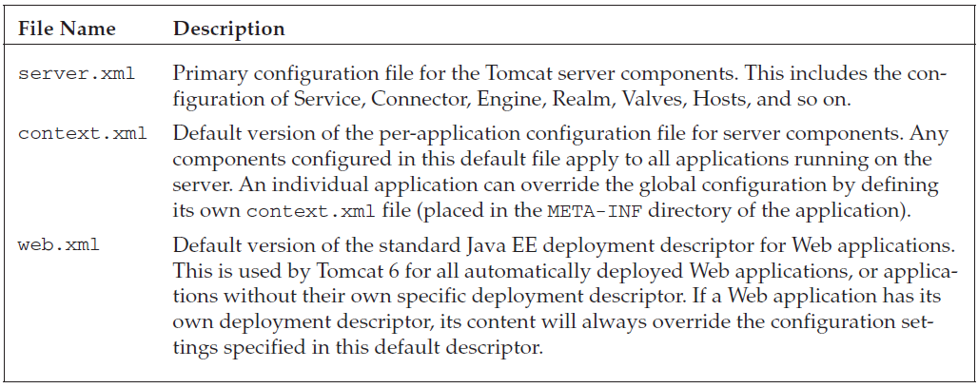
Configuration files and their roles

Slide 37
Logging Configuration

Slide 38
Agenda
Introduction
Java logging API — java.util.logging
Servlets logging API
Console
Access logging
Using java.util.logging (default)
Considerations for production usage
Using Log4j

Slide 39
Logging in Tomcat
The internal logging for Apache Tomcat uses JULI a packaged renamed fork of Apache Commons Logging.
It is hard-coded to use the java.util.logging framework.
This ensures that Tomcat's internal logging and any web application logging will remain independent, even if a web application uses Apache Commons Logging.
Notes:
To configure Tomcat to use an alternative logging framework for its internal logging, one has to replace the JULI implementation that is hard-coded to use java.util.logging with a JULI implementation that retains the full Commons Logging discovery mechanism. Such an implementation is provided as an extrascomponent.

Slide 40
Logging and Web Applications
A web application running on Apache Tomcat can:
Use any logging framework of its choice.
Use system logging API, java.util.logging.
Use the logging API provided by the Java Servlets specification, javax.servlet.ServletContext.log(...)

Slide 41
Java logging API — java.util.logging
Apache Tomcat implements its own logging based on commons logging API as JULI.
It has a custom LogManager Implementation aware of all running Web Applications.
It supports private per-application logging configurations.

Slide 42
Servlets logging API
The calls to javax.servlet.ServletContext.log(...) to write log messages are handled by internal Tomcat logging.
Such messages are logged to the category named
org.apache.catalina.core.ContainerBase.[${engine}].[${host}].[${context}]
This logging is performed according to the Tomcat logging configuration. You cannot overwrite it in a web application.
In Apache Tomcat implementation the calls to ServletContext.log(String) or GenericServlet.log(String) are logged at the INFO level.
The calls to ServletContext.log(String, Throwable) or GenericServlet.log(String, Throwable) are logged at the SEVERE level.

Slide 43
Console
In Unix and Linux the console log is directed to a file named “catalina.out”.
Whatever is written to System.err/out will be caught into that file.
When running as a service on Windows, the console output is also caught and redirected, but the file names are different.
The default logging configuration in Apache Tomcat writes the same messages to the console and to a log file.
This is great when using Tomcat for development, but usually is not needed in production

Slide 44
Access logging
Access logging is a related but different feature, which is implemented as a Valve.
It uses self-contained logic to write its log files.
The essential requirement for access logging is to handle a large continuous stream of data with low overhead, so it only uses Apache Commons Logging for its own debug messages. This implementation approach avoids additional overhead and potentially complex configuration.

Slide 45
Using java.util.logging (default)

Slide 47
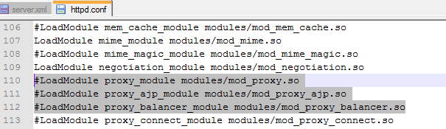
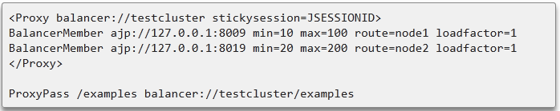
Mod_proxy in Apache

Slide 48
The ProxyPassReverse is used to change the headers sent by the app (appcluster) to Apache, before Apache sends it the browser. For example, if the app sits at http://localhost:9013/, and it tries to redirect the browser to, say, /new_location/, then it will respond with a redirect and location header of http://localhost:9013/new_location/, and Apache will take this and send it off to the browser. Problem is, the browser (assuming it's somewhere else) then tries to send a request to http://localhost:9013/new_location/, and gets an error.
What ProxyPassReverse does is intercepts those headers, and rewrites them so that they match what the Apache server that's doing the proxying looks like. So if my apache server is hosting http://myhost.com/ and I have a ProxyPass that points / to http://localhost:9013/App, if the application sitting at localhost:9013 returns a redirect to http://localhost:9013/App/new_location/, I'll need to use ProxyPassReverse so that it gets rewritten to http://myhost.com/new_location/ by Apache before sending the request back to the browser.
If you aren't issuing redirects, it's not going to be an issue, but it doesn't hurt to have it there in case a 301/302 redirect is returned. As far as mod_rewrite, the RewriteRule applies to the request going to the App, and not the response coming from the App. So they are mutually exclusive events.

Slide 52
Realms
Overview
What is a Realm?
Configuring a Realm
Common Features
Digested Passwords
Example Application
Manager Application
Realm Logging
Standard Realm Implementations
JDBCRealm
DataSourceRealm
JNDIRealm
UserDatabaseRealm
MemoryRealm
JAASRealm
CombinedRealm
LockOutReal

Slide 53
What is a Realm?
A Realm is a "database" of usernames and passwords that identify valid users of a web application (or set of web applications), plus an enumeration of the list of roles associated with each valid user.
Tomcat defines a Java interface (org.apache.catalina.Realm) that can be implemented by "plug in" components to establish this connection.

Slide 85
Monitor Tomcat with jconsole
Edit CATALINA_HOME/bin/catalina.sh to include
if [ -z "$CATALINA_BASE" ] ; then
CATALINA_BASE="$CATALINA_HOME"
fi
CATALINA_OPTS="-Dcom.sun.management.jmxremote
-Dcom.sun.management.jmxremote.port=9004
-Dcom.sun.management.jmxremote.ssl=false
-Dcom.sun.management.jmxremote.authenticate=false"
if [ -z "$CATALINA_TMPDIR" ] ; then
# Define the java.io.tmpdir to use for Catalina
CATALINA_TMPDIR="$CATALINA_BASE"/temp
fi

Slide 86
Start jconsole and connect
Go to a terminal window
Type jconsole
Select remote process
Enter tomcat-host:jmx-port you enterd in the previous slide
Done.

